Slide 1
Lesson Plan
Lesson Overview
Objective(s) | Divide a quantity in a given ratio |  |  |  |  | Grade | 4
Prior Knowledge | Basic operations Simplifying ratios
Duration | Suggested duration is 60 minutes for this objective
Resources | Print slides: 25 - 30 |  |  | Equipment
Progression of Learning
What are the students learning? |  | How are the students learning? (Activities & Differentiation)
Simple ratio sharing |  | PRINT slide 25. Using the 4 example questions on slides 4 to 7 show how to divide an amount into a given ratio. PRINT slide 26. Simple practice questions. |  |  |  |  | 10 10
How to set up a ratio. Listing the parts in the correct order and calculating the missing number(s) |  | PRINT slide 27. This contains 4 key ratio questions – all with slight variations but the set up of the information given in the question and finding the missing number is exactly the same. Using slides 9 to 12 explain each question with the students. |  |  |  |  | 15
Problem solving |  | PRINT slide 28. Contextualised problems followed by a true or false activity. |  |  |  |  | 10
Ratio sharing in exam questions (specimen papers) |  | PRINT slides 29 and 30. This includes 8 exam questions related to objective (including 2 from the curve 2.0). Students need to use notes from lesson to answer the questions. Ensure that all steps are shown. Relate to mark scheme to show how the marks are allocated. |  |  |  |  | 15
Next Steps | Recipe questions Direct and inverse proportion | Assessment | PLC/Reformed Specification/Target 4/Ratio, Proportion and Rates of Change/Ratio sharing

Slide 2
Title: Ratio Sharing
PBiS Focus
Empathy (kind words)
Learn (try, questions)
Aim:
Divide a given quantity into two parts in a given part : part or part : whole ratio.
Express the division of a quantity into two parts as a ratio

Slide 3
Ratio sharing
How can you check your answer?
1) Share £24 into the ratio 1 : 5
We add the parts of the ratio
1 + 5 = 6
To find each part, we divide £24 by 6
24 ÷ 6 = £4
This means one part is equivalent to £4
Since one gets 1 part = 1 x £4 = £4
Since the other gets 5 parts = 5 x £4 = £20

Slide 4
Ratio sharing
Why did we change 6m to 600cm?
2) Share 6m into the ratio 3 : 7
We add the parts of the ratio
3 + 7 = 10
To find each part, we divide 6m by 10
6m = 600cm , 600 ÷ 10 = 60
This means one part is equivalent to 60cm
Since one gets 3 parts = 3 x 60 = 180cm = 1.8m
Since the other gets 7 parts = 7 x 60 = 420cm = 4.2m

Slide 5
Ratio sharing
3) In a maths test, the ratio of marks given for method to accuracy is 5:3. If Bill scored 39 marks for accuracy, what was his total mark?
39 marks refers to 3 parts,
therefore 1 part is 39 ÷ 3 = 13 marks.
Method marks refer to 5 parts, 5 x 13 = 65 marks
His total mark, 39 + 65 = 104 marks

Slide 6
Ratio sharing
4) Isabella and Louisa share their money in the ratio 3 : 7. If Louisa gets £84 more than Isabella, how much money have they in total?
Isabella Louisa
3 : 7
If Louisa has £84 more, this refers to the difference in parts of the ratio. 7 – 3 = 4.
If 4 parts is £84, then 1 part is £84 ÷ 4 = £21
If Isabella has 3 shares, then she has £21 x 3 = £63
If Louisa has 7 shares, then she has £21 x 7 = £147
In total, they have £63 + £147 = £210

Slide 7
Ratio sharing practice
1) Share the following into the given ratios:
(a) £70 in the ratio 2:3
(b) 3kg in the ratio 9:11
(c) 9m in the ratio 4:5
2)In April, the ratio of sunny days to rainy days is 1:2. How many days were rainy?
3)There are 5p and 2p coins in a bag. The ratio of 5p coins to 2p coins is 3 : 7. If the value of the bag adds to £2.90, how many 2p coins are in the bag?
a) £28 : £42
4) Tyler and Kate share £91 in the ratio 4 : 3.
Work out how much money each person gets.
4 + 3 = 7
91/7 = 13
Tyler: 4 × 13 = £52
Kate: 3 × 13 = £39
5) Ryan and Simon share £72 in the ratio 4 : 8.
Work out how much money each person gets.
4 + 8 = 12
72/12 = 6
Ryan: 4 × 6 = £24
Simon: 8 × 6 = £48
6) Manisha and Alex share £600 in the ratio 62 : 58.
Work out how much money each person gets.
62 + 58 = 120
600/120 = 5
Manisha: 62 × 5 = £310
Alex: 58 × 5 = £290
b) 1350g : 1650g or 1.35Kg : 1.65 kg
c) 4m : 5m
20
70

Slide 8
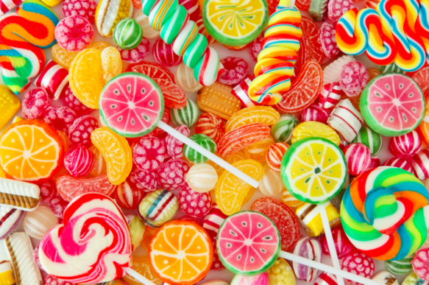
Ratio sharing contexualised question
Paul and Katie share some sweets in the ratio 3:8
Katie gets 32 sweets.
How many sweets does Paul get?
P : K
32
8
=4
3 : 8
12
: 32
3 x 4 = 12
Notes:
Guide
P: K
3: 8
?: 32
X4 so = 12

Slide 9
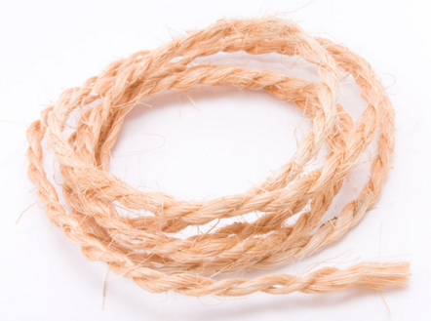
Ratio sharing contexualised question
Sandra has a piece of string 150cm long.
She cuts the string into three lengths in the ratio 5:2:3
Work out the length, in cm, of each piece of string.
5 : 2 : 3
=10 parts
150
10
= 15
=150cm
75 : 30 : 45
5 x 15 = 75
Notes:
Guide

Slide 10
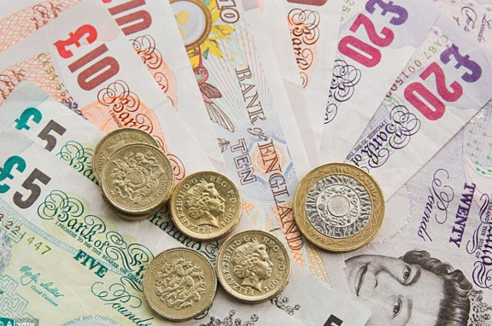
Ratio sharing contexualised question
Pat and Julie share some money in the ratio 2:5
Julie gets £45 more than Pat.
How much money did Pat get?
5 – 2 = 3
45
3
P : J
= 15
2 : 5
30 :
2 x 15 = 30
Notes:
Guide

Slide 11
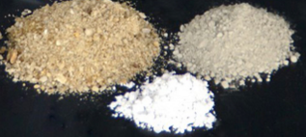

Ratio sharing contexualised question
Talil is going to make some concrete mix.
He needs to mix cement, sand and gravel in the ratio 1:3:5 by weight.
Talil wants to make 180 kg of concrete mix.
Talil has 15kg of cement, 85kg of sand, 100kg of gravel
Does he have enough cement, sand and gravel?
C : S : G
= concrete
180
9
= 20
1 : 3 : 5
= 9 parts
1 x 20 = 20
3 x 20 = 60
5 x 20 = 100
= 180 kg
20 : 60 : 100
No Talil does not have enough cement
Notes:
Guide

Slide 12
Problem solving and reasoning Q1
Kate, Drake and Ed share £350 between them.
Kate receives £120 more than Drake.
The ratio of Kate’s share to Drake’s share is 13 : 3
Work out the ratio of Ed’s share to Drake’s share.
Give your answer in its simplest form.
120 + Drake = Kate
13 – 3 = 10
120 ÷ 10 = £12 = 1 part
13 × £12 = £156 : Kate
3 × £12 = £36 : Drake
£156 + £36 = £192
£350 - £192 = £158
158 : 36
79 : 18
÷ 2
÷ 2

Slide 13
Problem solving and reasoning Q2
One litre of green paint can be made by mixing yellow and blue in the ratio 1 : 9. Sally adds more yellow to make lighter green so the ratio of yellow to blue is 1 : 2. Sally now wants the colour to be more blue so the ratio is 1 : 3. How much blue paint does she need to add?
1 litre = 1000ml
1+9 = 10 parts all together. 1000ml ÷ 10 = 100ml
In the paint mixture there is, 1 x 100ml = 100ml yellow
9 x 100ml = 900ml blue paint
yellow blue
100 : 900 If Sally adds yellow to make ratio 1 : 2,
+350ml more yellow. She now has 450ml yellow and 900ml blue.
If Sally would like the ratio to be 1 : 3, then she needs 3 x 450ml= 1350ml blue. She already has 900ml, so she needs to add 450ml of blue.

Slide 14
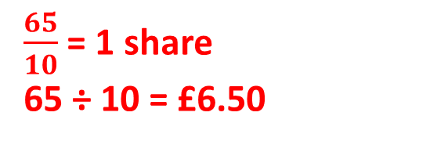
Problem solving and reasoning Q3
Tom, Ben and David share £65
Ben gets three times as much money as Tom. David gets twice as much money as Ben. How much money does David get?
a is the share in pounds each person has
T : B : D
a : 3 x a : 3 x a x 2
a : 3a : 6a
Calculate each share as a ratio using the information provided
Total of 10 shares
$\frac{65}{10}$ = 1 share
65 ÷ 10 = £6.50
David has 6 shares therefore 6 x 6.50 = £39

Slide 15
True or false?
A bag contains 10 yellow balls, 20 red balls and 25 blue balls. The ratio is 2 : 10 : 5
A wallet contains 16, 2p coins, 24, 10p coins and 6, 50p coins. The ratio is 4 : 6 : 3
A jar contains 36 green marbles, 54 orange marbles and 60 pink. The simplified ratio is 18 : 27 : 30
False
False
False

Slide 16
Ratio sharing
Share £24 into the ratio 1 : 5
Share 6m into the ratio 3 : 7
In a maths test, the ratio of marks given for method to accuracy is 5:3. If Bill scored 39 marks for accuracy, what was his total mark?
Isabella and Louisa share their money in the ratio 3 : 7. If Louisa gets £84 more than Isabella, how much money have they in total?
Student Sheet 1

Slide 17
Ratio sharing practice
1) Share the following into the given ratios:
(a) £70 in the ratio 2:3
(b) 3kg in the ratio 9:11
(c) 9m in the ratio 4:5
2)In April, the ratio of sunny days to rainy days is 1:2. How many days were rainy?
3)There are 5p and 2p coins in a bag. The ratio of 5p coins to 2p coins is 3 : 7. If the value of the bag adds to £2.90, how many 2p coins are in the bag?
4) Tyler and Kate share £91 in the ratio 4 : 3.
Work out how much money each person gets.
5) Ryan and Simon share £72 in the ratio 4 : 8.
Work out how much money each person gets.
6) Manisha and Alex share £600 in the ratio 62 : 58.
Work out how much money each person gets.
Student Sheet 2

Slide 18
Ratio sharing contextualised practice
Sandra has a piece of string 150cm long.
She cuts the string into three lengths in the ratio 5:2:3
Work out the length, in cm, of each piece of string.
Paul and Katie share some sweets in the ratio 3:8
Katie gets 32 sweets.
How many sweets does Paul get?
Pat and Julie share some money in the ratio 2:5
Julie gets £45 more than Pat.
How much money did Pat get?
Talil is going to make some concrete mix. He needs to mix cement, sand and gravel in the ratio 1:3:5 by weight. Talil wants to make 180 kg of concrete mix.
Talil has 15kg of cement, 85kg of sand, 100kg of gravel. Does he have enough cement, sand and gravel?
Student Sheet 3
Notes:
Guide
P: K
3: 8
?: 32
X4 so = 12

Slide 19
Problem solving and reasoning
Q1: Kate, Drake and Ed share £350 between them.
Kate receives £120 more than Drake.
The ratio of Kate’s share to Drake’s share is 13 : 3
Work out the ratio of Ed’s share to Drake’s share.
Give your answer in its simplest form.
Q2: One litre of green paint can be made by mixing yellow and blue in the ratio 1 : 9. Sally adds more yellow to make lighter green so the ratio of yellow to blue is 1 : 2. Sally now wants the colour to be more blue so the ratio is 1 : 3. How much blue paint does she need to add?
Q3: Tom, Ben and David share £65. Ben gets three times as much money as Tom. David gets twice as much money as Ben. How much money does David get?
A bag contains 10 yellow balls, 20 red balls and 25 blue balls. The ratio is 2 : 10 : 5
A wallet contains 16, 2p coins, 24, 10p coins and 6, 50p coins. The ratio is 4 : 6 : 3
A jar contains 36 green marbles, 54 orange marbles and 60 pink. The simplified ratio is 18 : 27 : 30
True or false?
Student Sheet 4

Slide 20
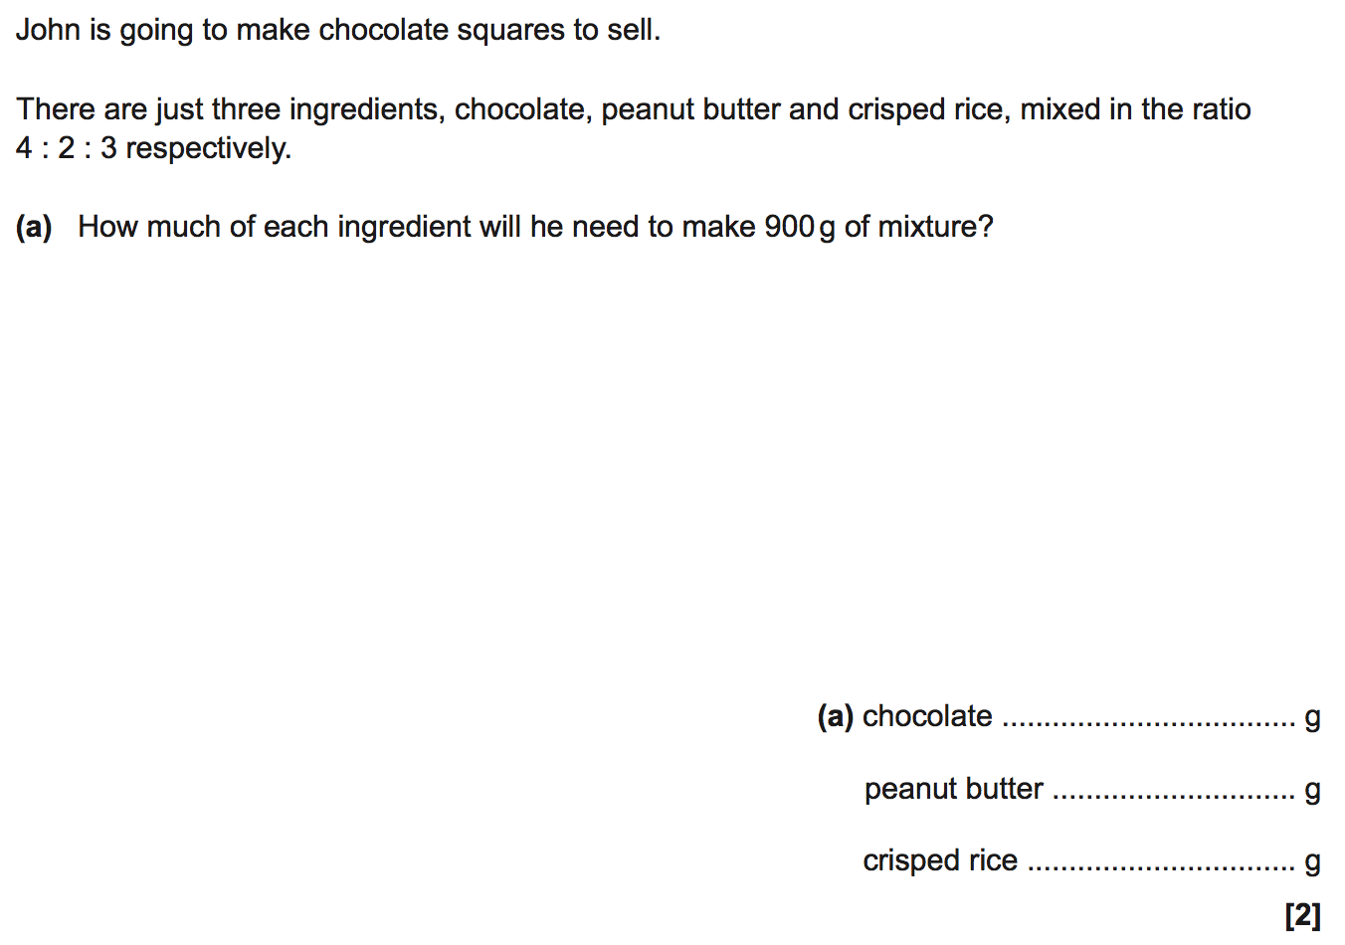
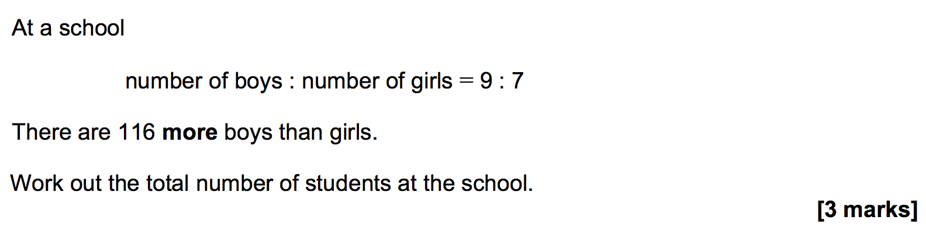
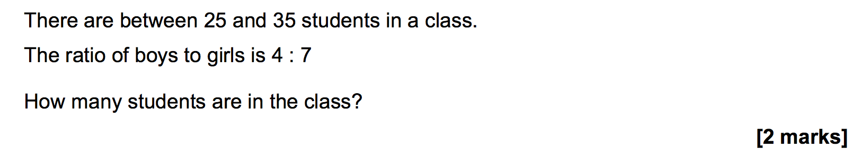
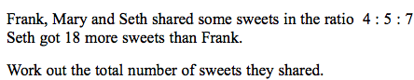
Exam specimen questions
[3 marks]
Student Sheet 5

Slide 21
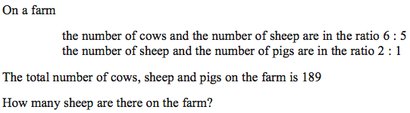
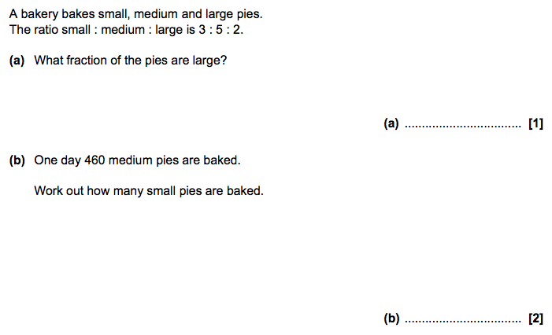
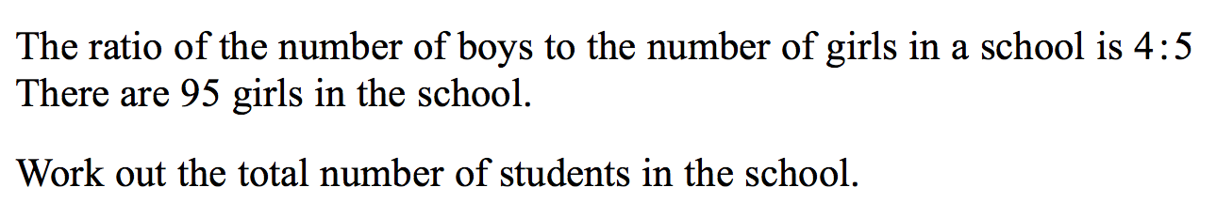
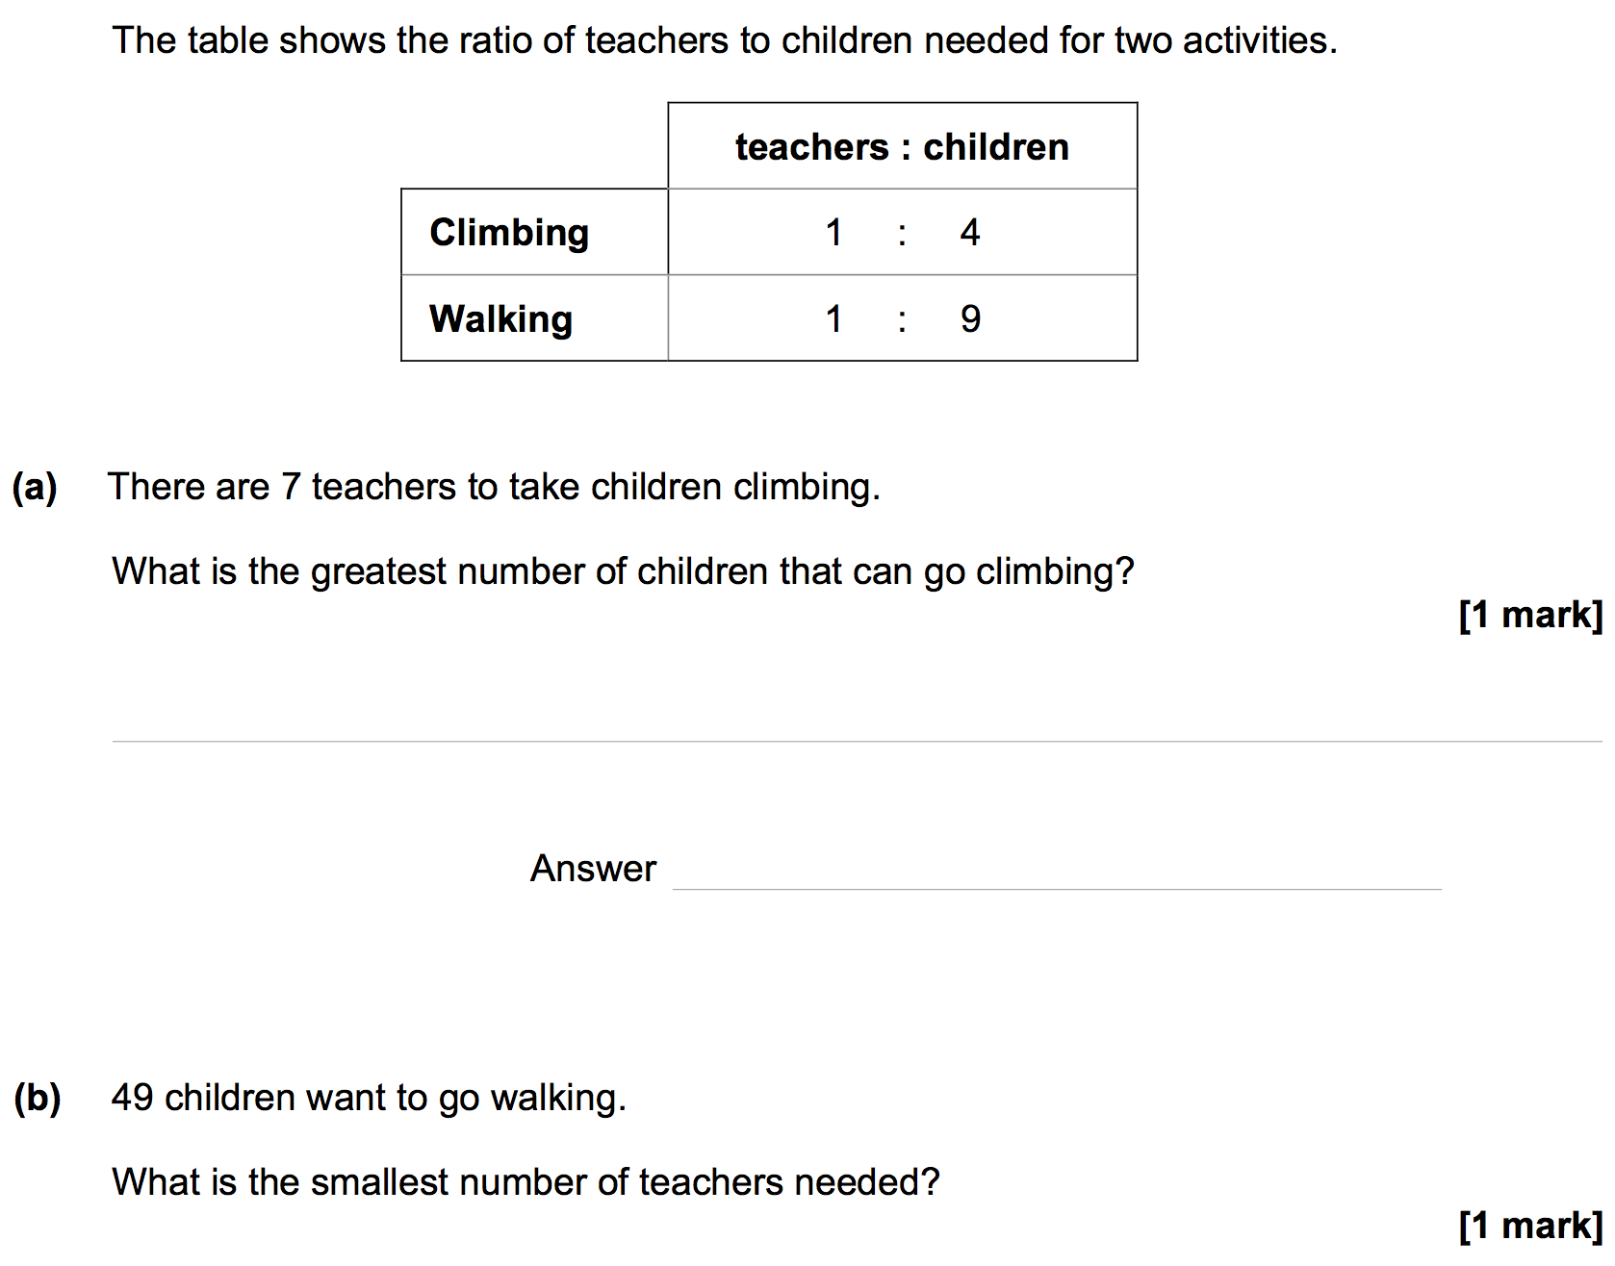
Exam specimen questions
[3 marks]
[3 marks]
Student Sheet 6

